Slide 1
Matematisk modellering II
Guttorm Alendal

Slide 2
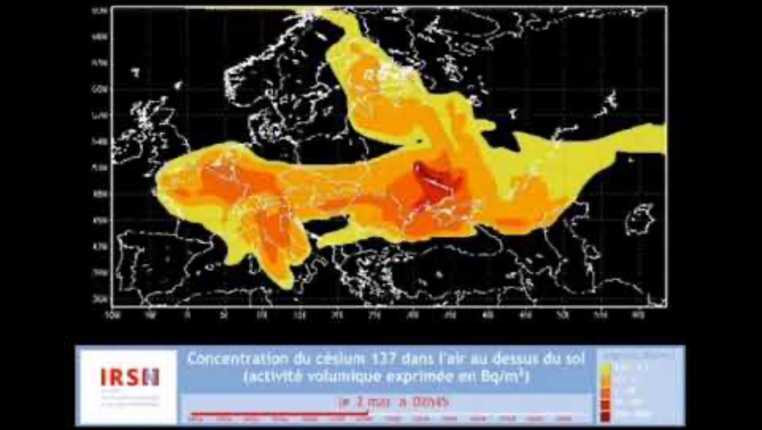
Tjernobyl, 1986

Slide 3

Wicked problems.
From Wikipedia: In planning and policy, a wicked problem is a problem that is difficult or impossible to solve because of incomplete, contradictory, and changing requirements that are often difficult to recognize. It refers to an idea or problem that cannot be fixed, where there is no single solution to the problem; and "wicked" denotes resistance to resolution, rather than evil. Another definition is "a problem whose social complexity means that it has no determinable stopping point". Moreover, because of complex interdependencies, the effort to solve one aspect of a wicked problem may reveal or create other problems. Due to their complexity, wicked problems are often characterized by organized irresponsibility.
Climate change, sixth mass extinction, systemic racism, widening economic inequality, hunger, antimicrobial resistance, energy, pandemic,….
Plastic?

Slide 4
Super wicked problems
There is a significant time deadline on finding the solution
There is no central authority dedicated to finding a solution
Those seeking to solve the problem are also causing it
Certain policies irrationally impede future progress

Slide 5
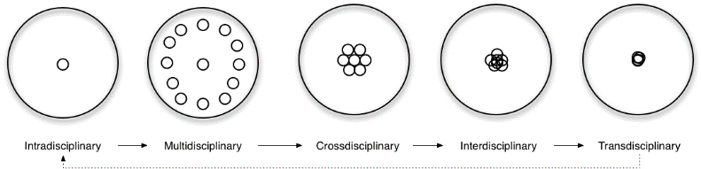
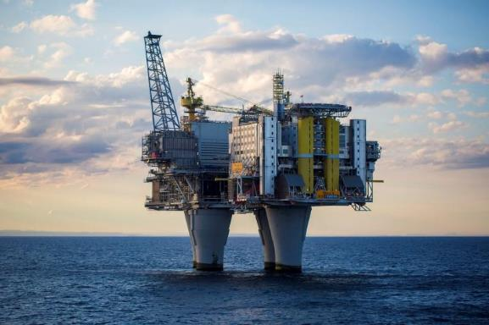
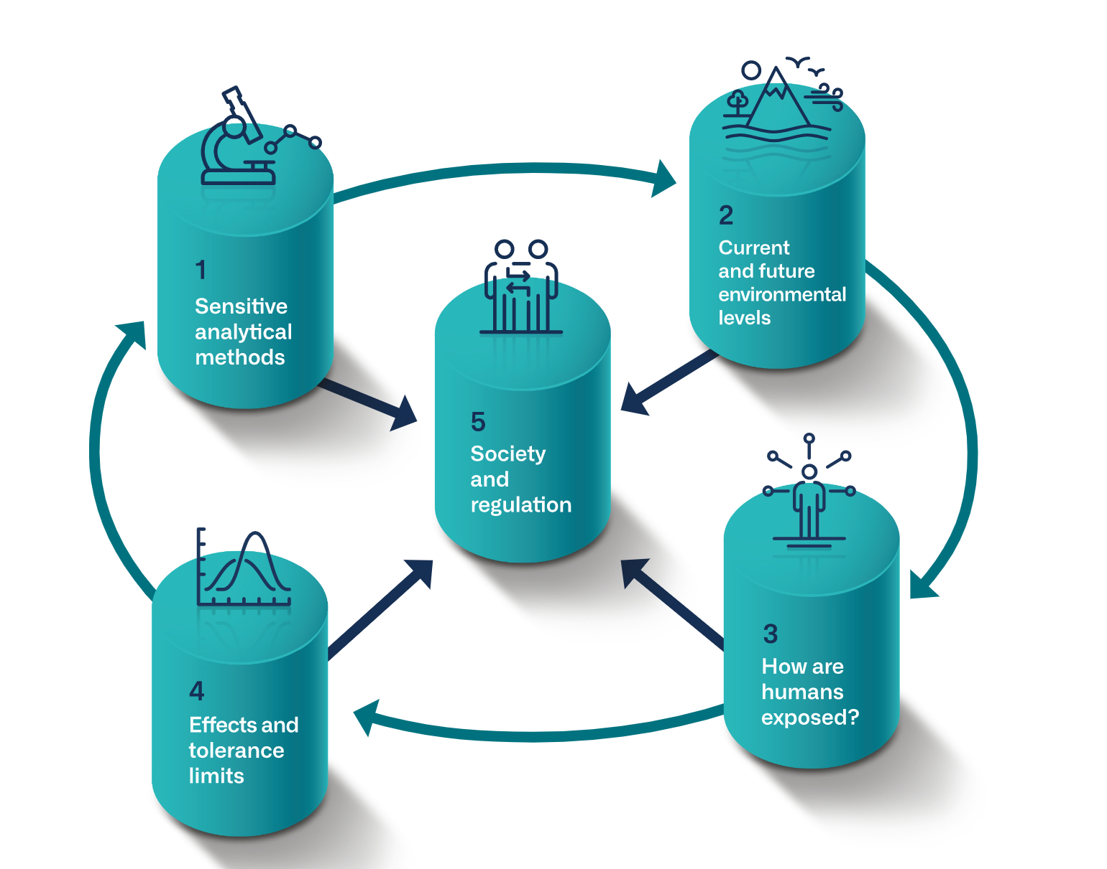

Intra-multi-cross-inter-trans-disciplinary

Slide 6
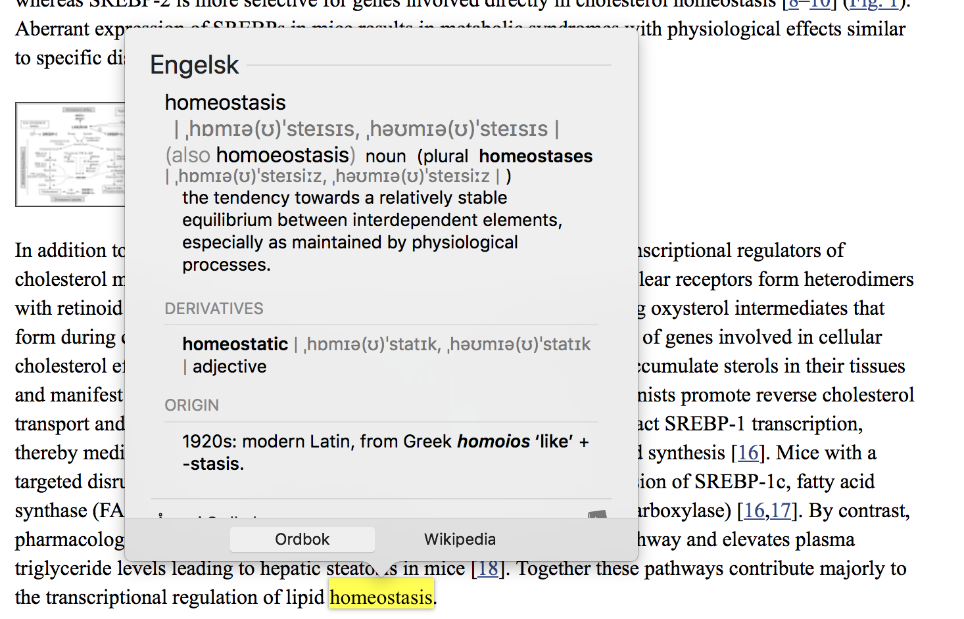

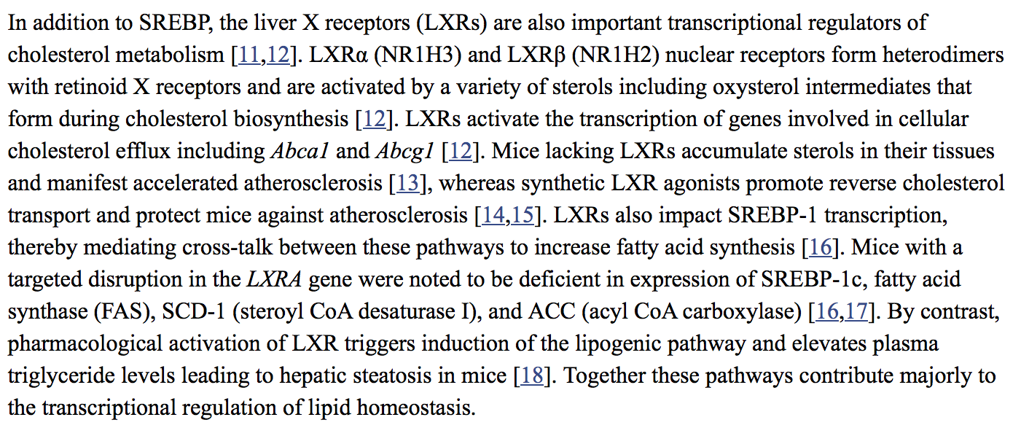
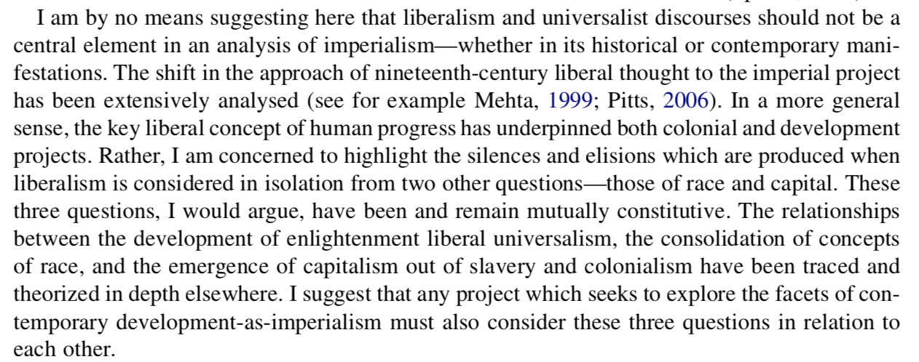
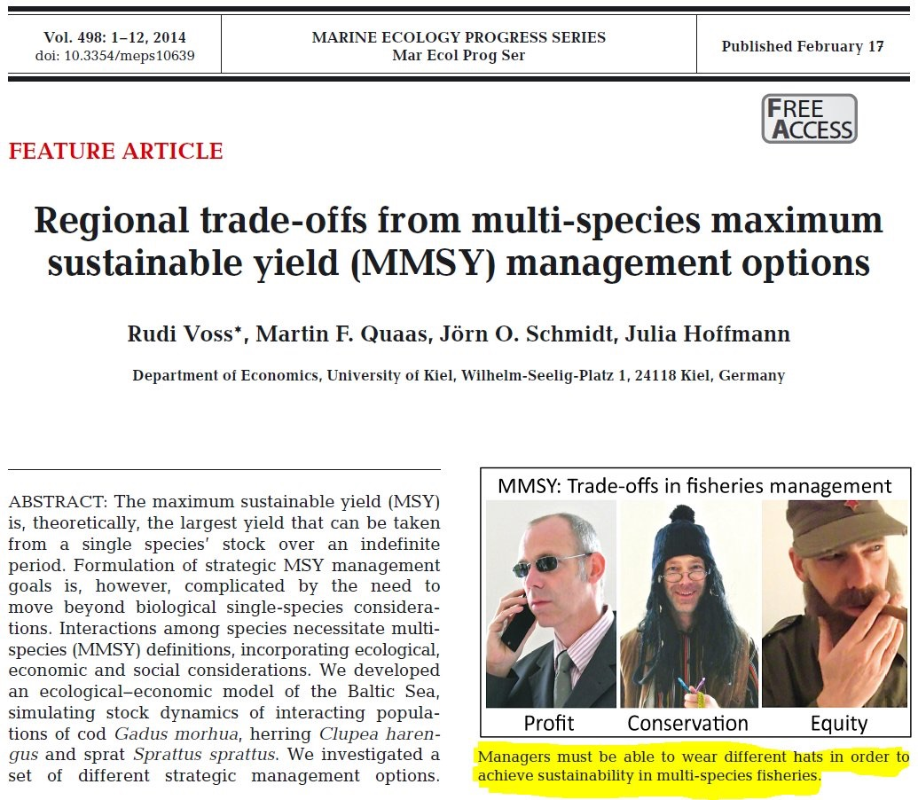
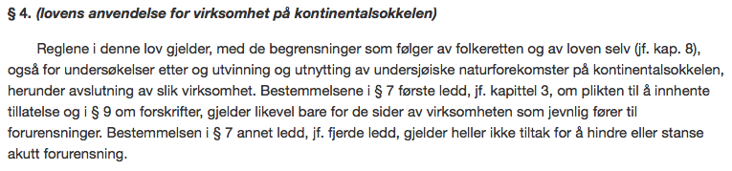
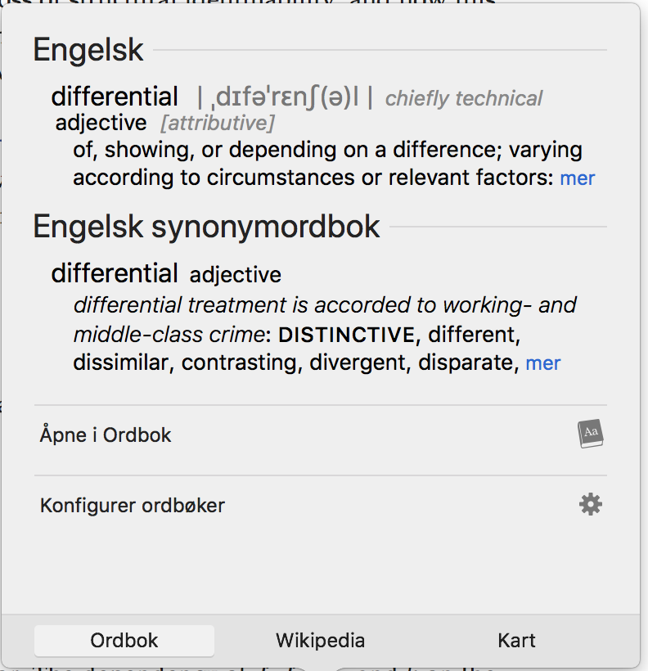

Slide 7
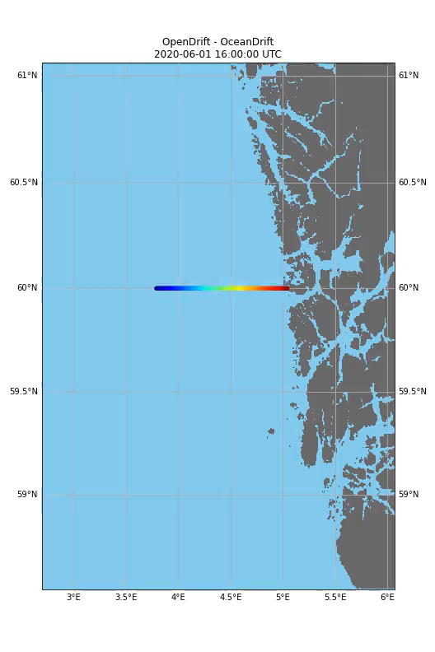
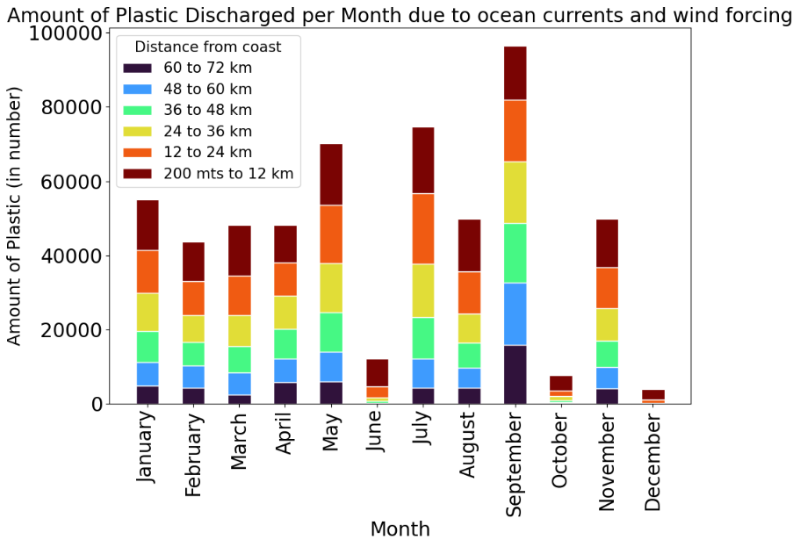
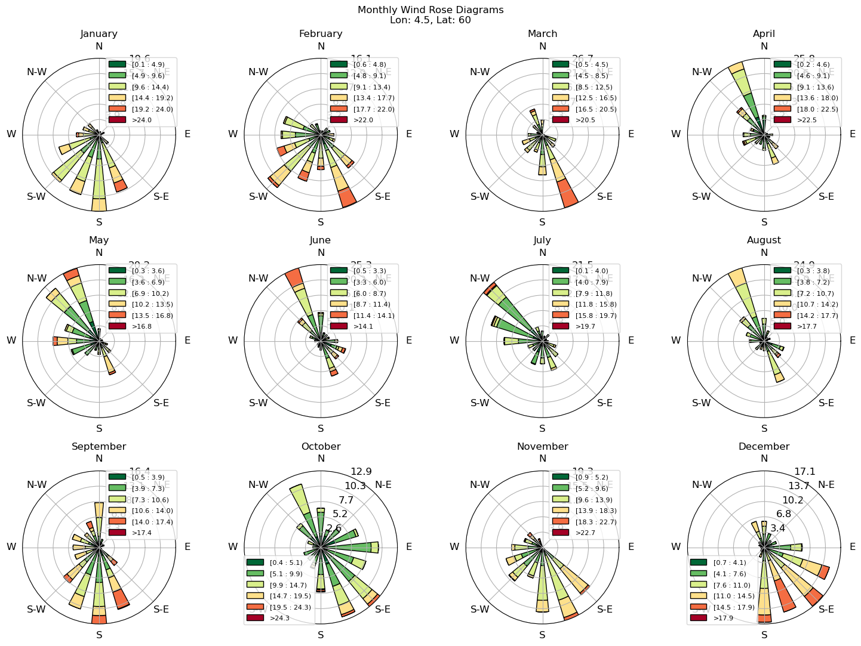
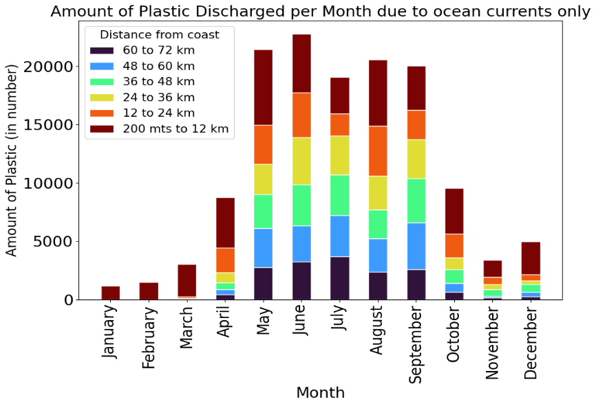
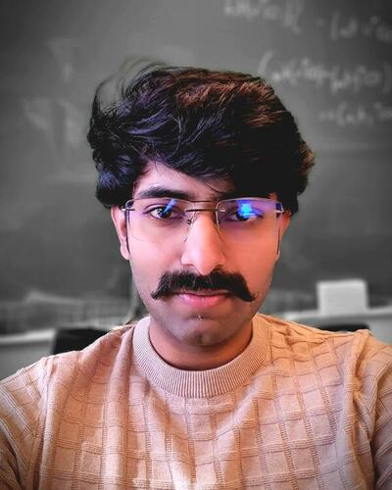



Researcher Exchange
Aligned work
Plastic in the North Atlantic (refresher)
Research project
Research questions
Broad scale modelling
Local modelling
Conclusions
Future plans
Prithvinath
Madduri

Slide 8
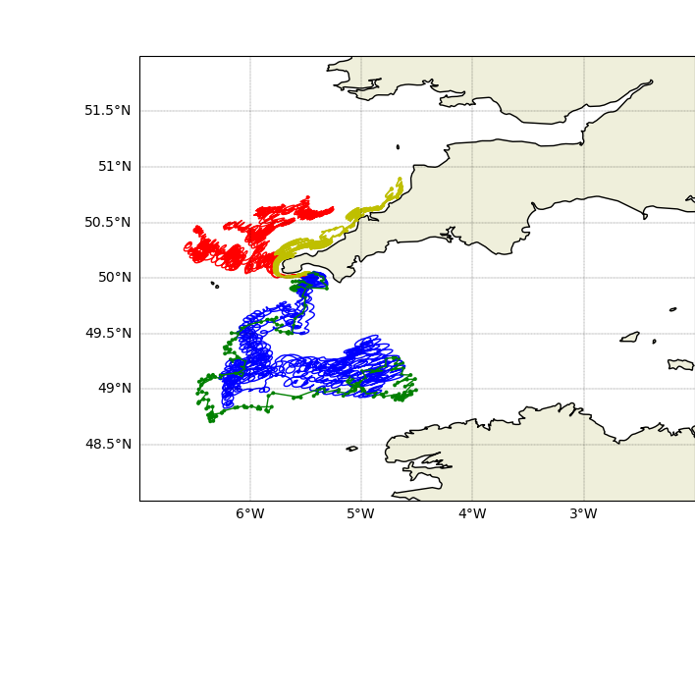
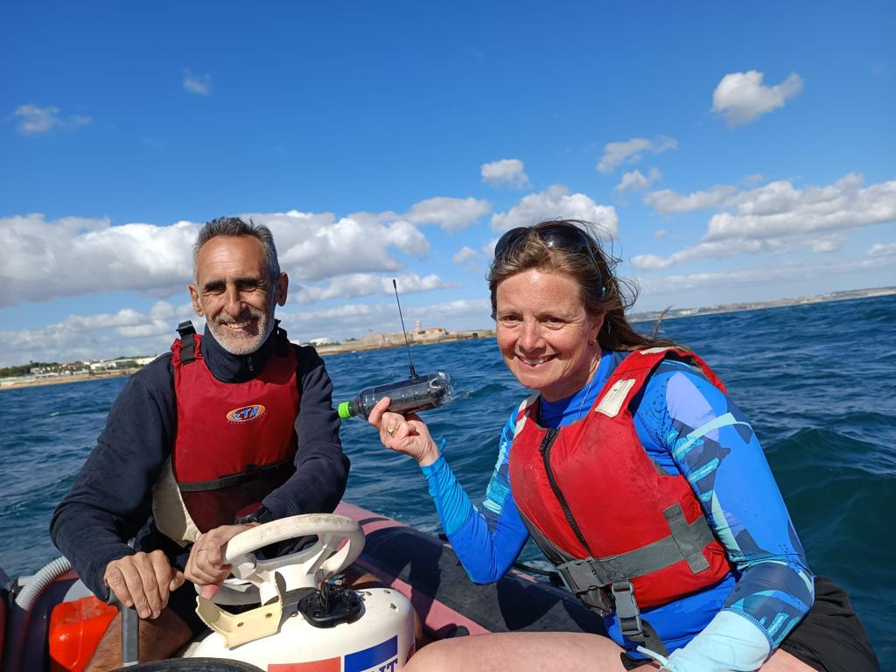
Researcher Exchange
Parameterization of particle transport dynamics
Although much work has been done on modelling different objects in the ocean, there is relatively little data on how many common litter items moves.
A recent exception has arisen through a project that has designed, built and deployed GPS tagged plastic bottles.
Aligned work
Plastic in the North Atlantic (refresher)
Research project
Research questions
Broad scale modelling
Local modelling
Key
Green – bottle track
Red – model tracks using surface ocean currents**
Yellow – model tracks using surface ocean currents + waves
Blue – model tracks using surface ocean currents + wind
Conclusions
Future plans

Slide 9

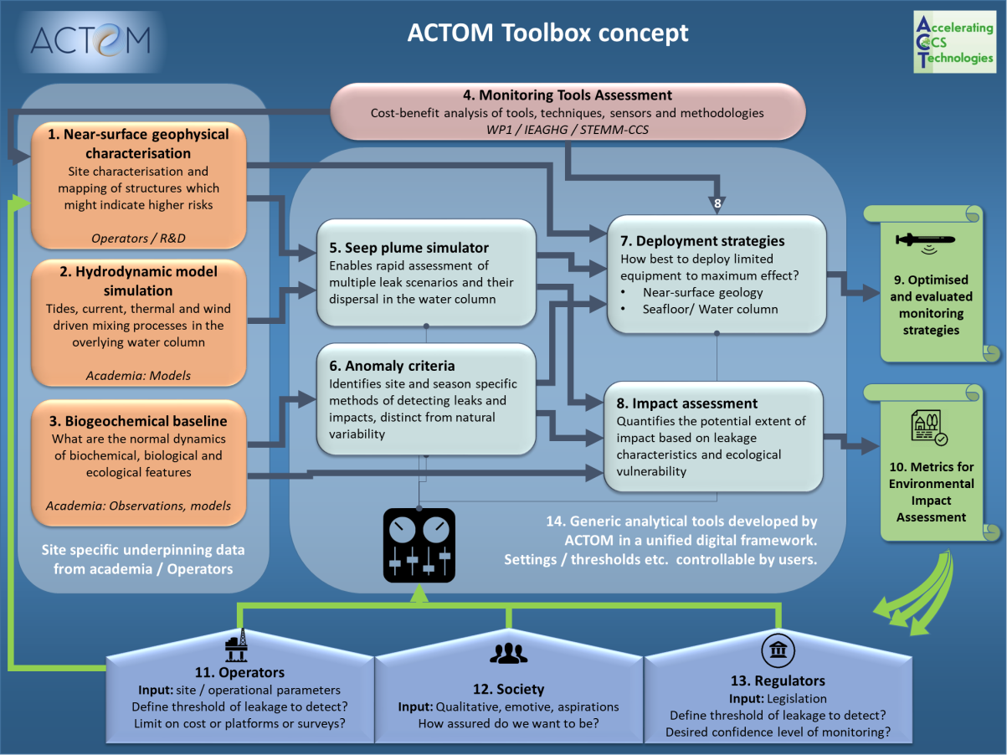
The ACTOM project
https://actom.w.uib.no
WP1 BASELINE (Abdirahman Omar, NORCE-Climate, Sigrid E. Schütz, UiB-Law): Monitoring the marine environment. Will survey the regulatory requirements and opportunities and technical limitations laying the foundation for the marine monitoring program. This activity will underpin the other WPs, providing the necessary information on what level of assurance is expected from a monitoring program, alongside the present capabilities of marine measurements and monitoring.
WP2 DIGITAL (Jerry Blackford, PML): Design and build of the pre-operational web toolkit. Will be responsible for building the toolkit based on verified algorithms for detecting weak signals in a highly variable environment and designing monitoring programs.
WP3 RESPONSIBILITY (Dorothy Dankel UiB-BIO, Sigrid E. Schütz, UiB-Law): Responsible CCUS monitoring process. Will study how the monitoring program can be used to communicate risks and benefits of subsea storage, and as a tool for public engagement through the Responsible Research and Innovation (RRI) framework.
WP4 IMPACT (Sarah Gasda, NORCE-energy): Scenarios and site studies. Will utilize the web toolkit built in WP2 and the knowledge learned in WP3 to study policy scenarios and demonstrate the toolkit on the P18 and Smeaheia storage sites as well as study sites in the Gulf of Mexico.
WP5 INTEGRATION (Guttorm Alendal, UiB-MATH): Dissemination, reporting and coordination. Assure easy communication in this highly cross-disciplinary project, both in the core project group, in the extended collaboration group, and beyond the project. Responsible to periodic reporting to ACT.

Slide 10
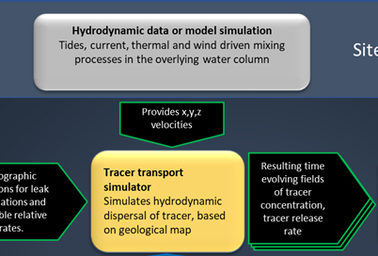
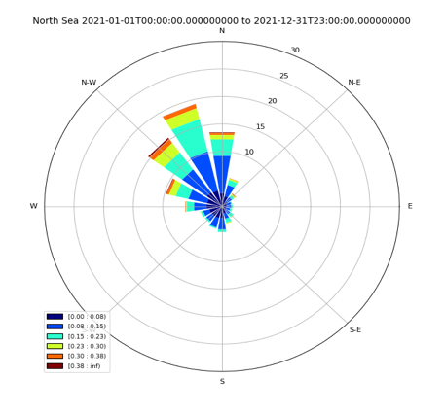
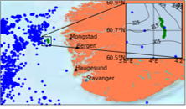
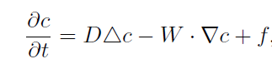
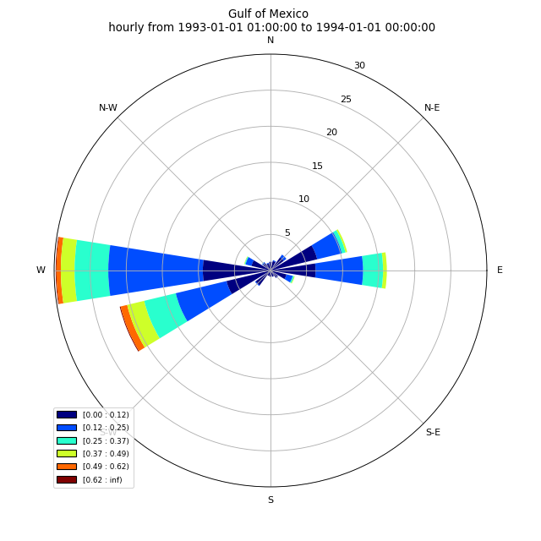
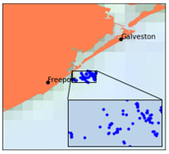
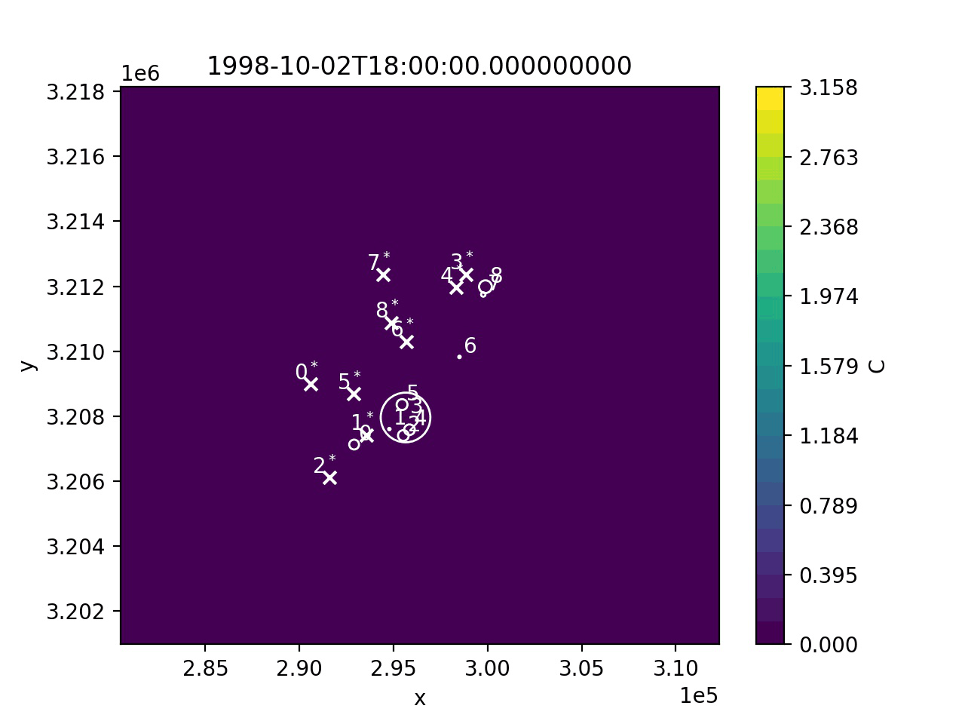
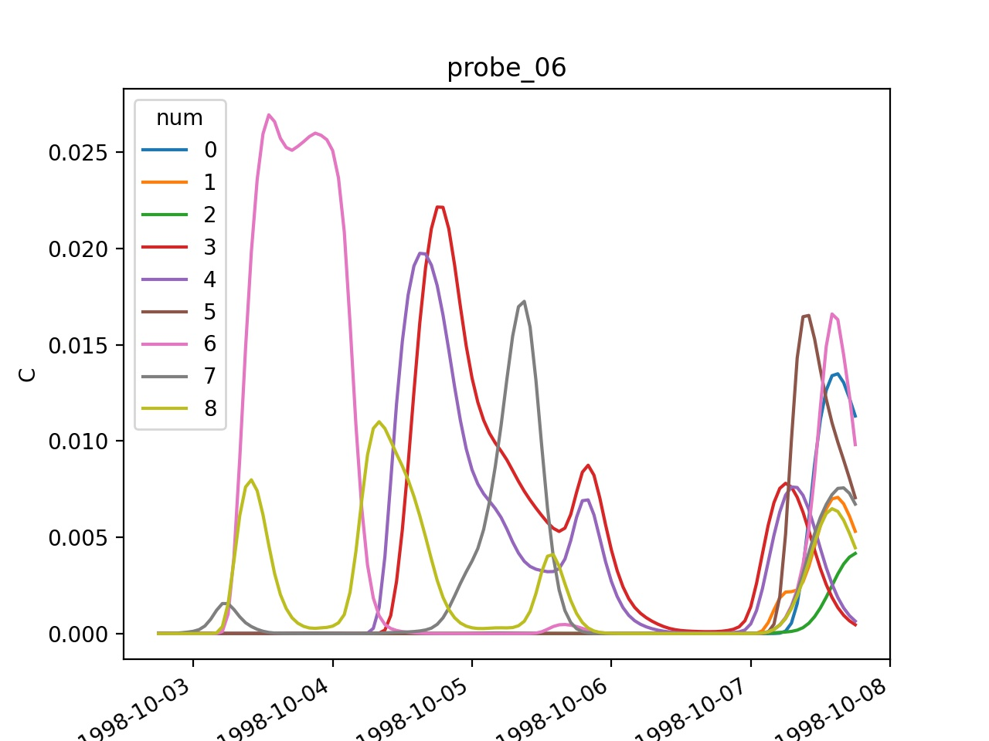
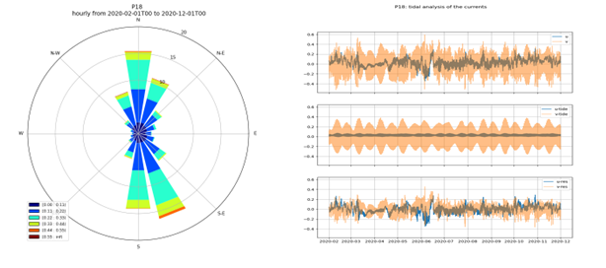
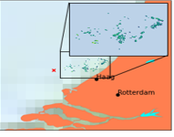

Slide 11
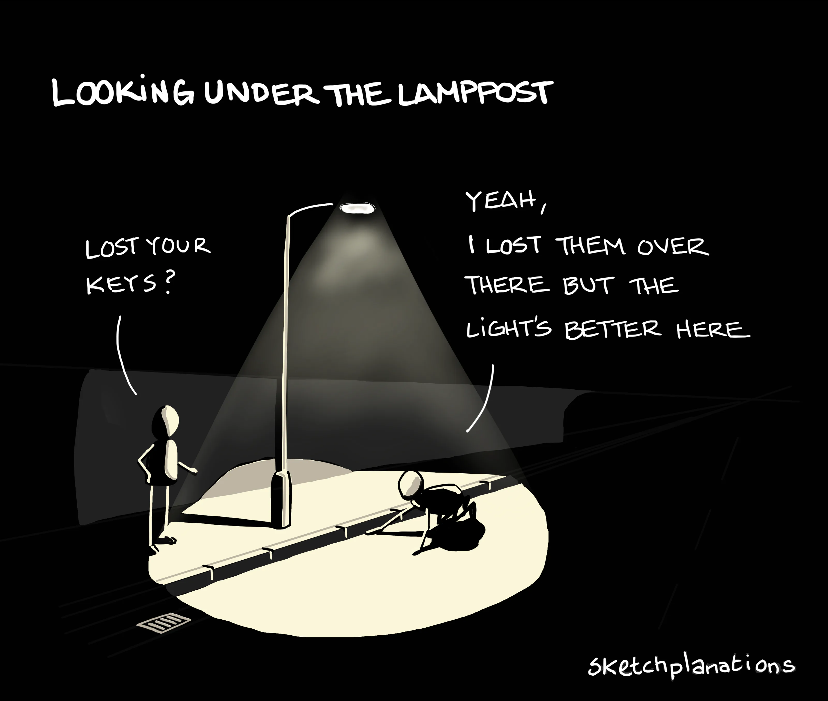
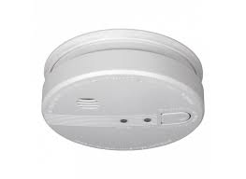


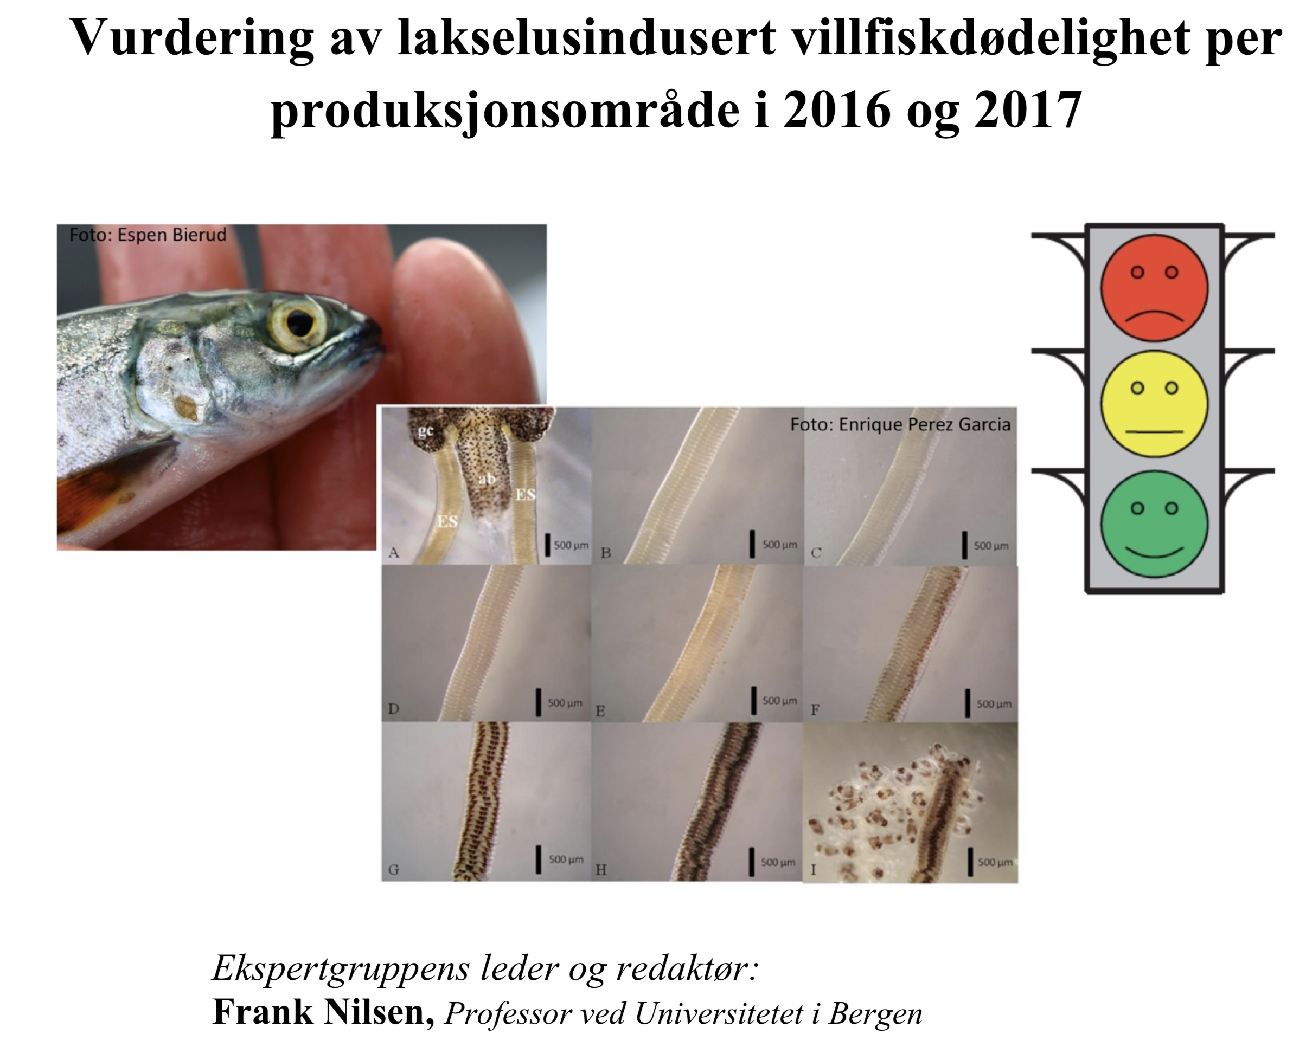
Belief/Reality | True | False
True |  | False positive
False | False negative
False positives/False negatives
We are studying targeted monitoring of potential seeps at an analog storage site, this is not equivalent to state that we think there will be a leak!

Slide 12
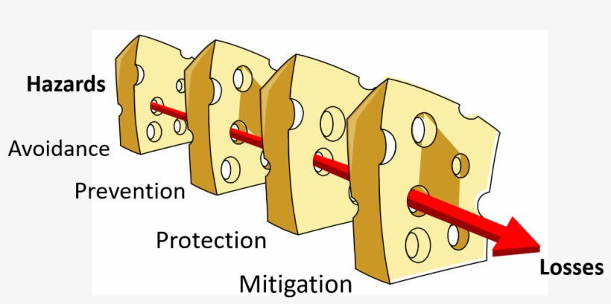
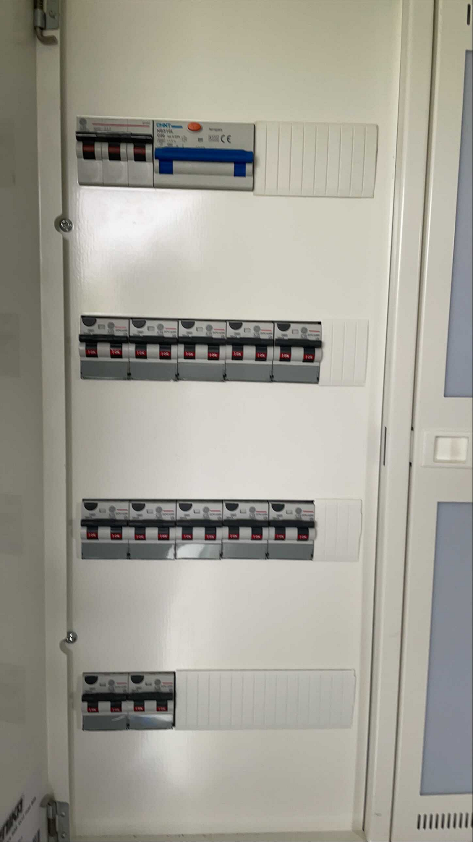
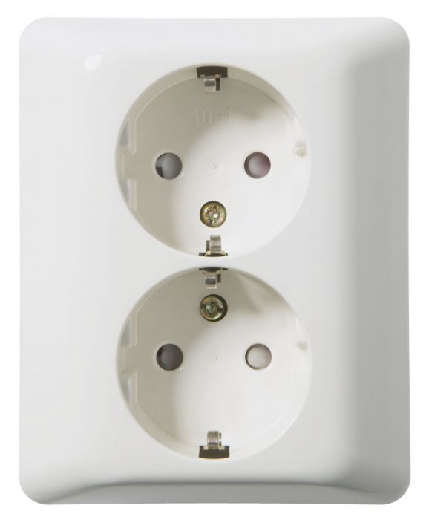
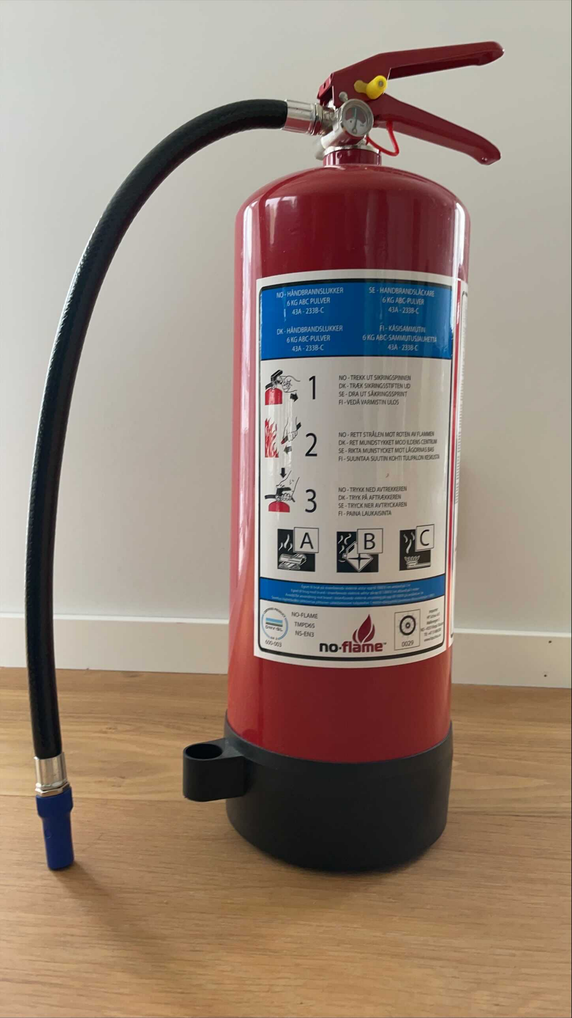

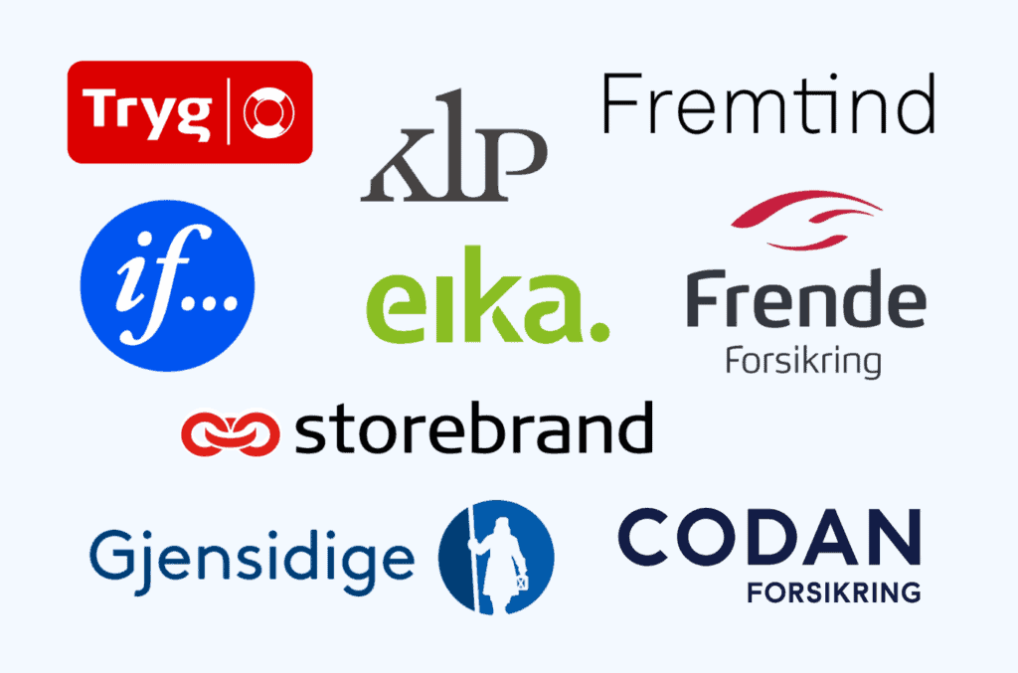
Belief/Reality | True | False
True |  | False positive
False | False negative
False positives/False negatives

Slide 14
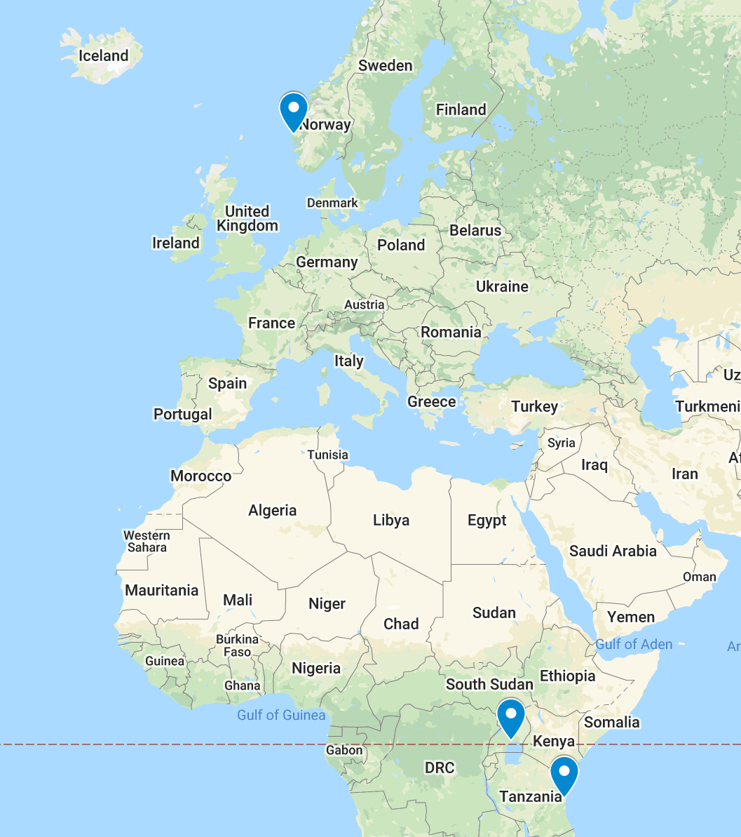
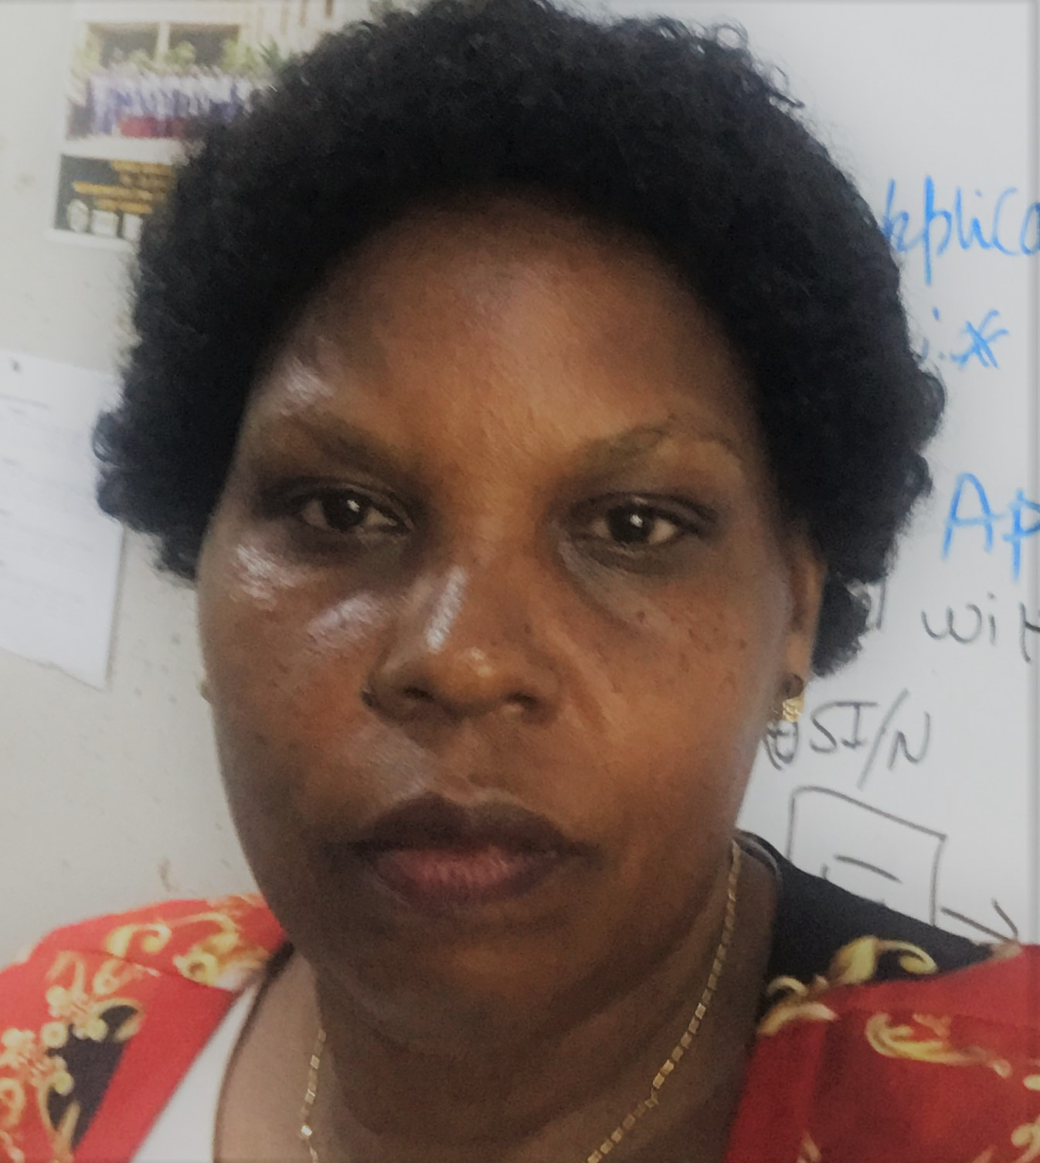
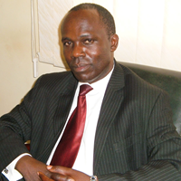
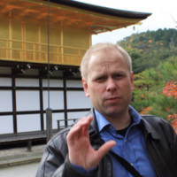
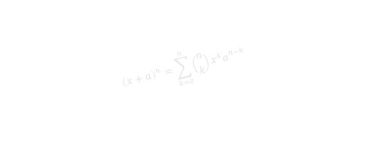
Mathematics for sustainability
Departments of Mathematics and College of Education University of Dar es Salaam, Tanzania
Professor Eunice Mureithi, PI
Dr. Sylvester E. Rugeihyamu, Prof. Allen Mushi, Dr. Egbert Mujuni, Dr. Septimi Kitta,
PhD students: Elimercy Eustace, Sosoma Innocent, Ema Boki, Honorata Kihaga, Leonce Leandry, Abdul-rahman Japhary Mumbu
Department of Mathematics and College of Education and External Studies Makerere University, Uganda
Professor John Mango Magero, PI
Dr. Godfrey Mayende, Dr. Sande Obondo
PhD students: Gaanya Ismail, Ssali Celester, Namugera Frank, Katende Ronald, Afazali Zabibu
Department of Mathematics, University of Bergen, Norway
Professor Guttorm Alendal, PI
Professor Bettina Dahl Søndergaard, Professor Bård Støve, Associate Professor Morten Brun, Dr. Anna Olyenik,
Associate Professor Stein Andreas Bethuelsen, professor Helge K. Dahle.
$${\left(x+a\right)}^{n}=\sum_{k=0}^{n}{\left({n \atop k}\right)x^{k}a^{n−k}}$$
https://math4sdg.w.uib.no

Slide 15

The project
Project start: January 1st, 2021.
Project end: December 31, 2026
Total budget: 20 mioNOK.
Impact:
Better use of mathematical methods to achieve sustainability
Outcome:
Higher quality mathematics research.
Outcome:
Updated mathematics education.
Outcome:
Better mathematical literacy in society.
Output:
Staff better qualified for research project within applied mathematics, statistics and mathematics didactics.
7 PhD students in applied and computational mathematics.
Output:
Updated math educational programmes.
More accessible studies; online teaching.
4 PhDs in mathematical didactics
Output:
Established network with industry and government.
Online coursework for secondary schools, including for teachers.
Popular science articles, illustrative web projects.
https://math4sdg.w.uib.no

Slide 16
The PhD students.
Leonce Leandry (UDSM) | The fuzzy Modeling approach on the dynamics of Infectious diseases: A case of Monkeypox virus.
Selester Ssali (Mak) | Interventions Of Problem-Based Learning To Improve The Teaching Of Algebra In Selected Secondary Schools In The Mityana District
Honorata Kihaga (UDSM) | Handling Large Mathematics Classes in Secondary Schools in Tanzania
Frank Namugera (Mak) | Phase transitions in a long-range supercritical contact process
Elimercy Ntagalinda (UDSM) | Modelling the Effects of Antimicrobial Resistance on Typhoid Fever Transimission Dynamics with some Control Strategies
Ronald Katende (Mak) | Physics-Informed Neural Networks vs Finite difference method for solving parabolic, elliptic and hyperbolic PDEs
Ema Boki (UDSM) | The use of GeoGebra in improving students mathematics conceptual understanding and problem solving skills in secondary schools: A review of Literature.
Zabibu Afazali (Mak) | Modeling dependencies in general insurance claims using copulas
Abdulraham Mumbu (UDSM) | Application of Optimal and Adaptive control measures to TB disease associated with drug susceptibility and drug resistance: A Mathematical Modelling Approach
Ismael Gaanya (Mak) | Project-Based Interventions In Teaching Mathematics For Sustainable Development: Experiences Of Secondary Teachers And Students In Uganda
Innocent Sosoma (UDSM) | Modelling the role of age structure and antimicrobial resistance bacteria on transmission dynamics of brucellosis

Slide 17
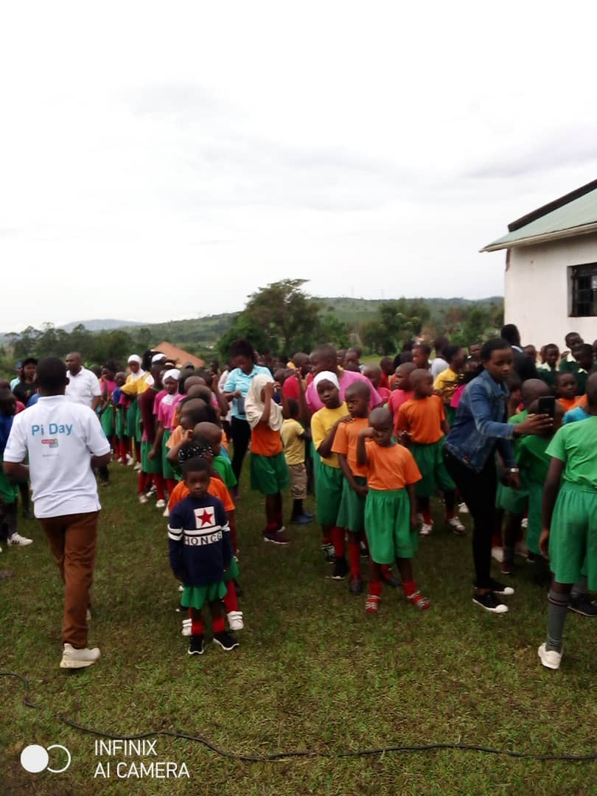
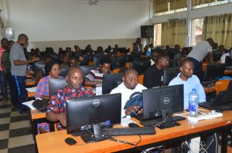
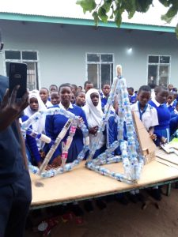
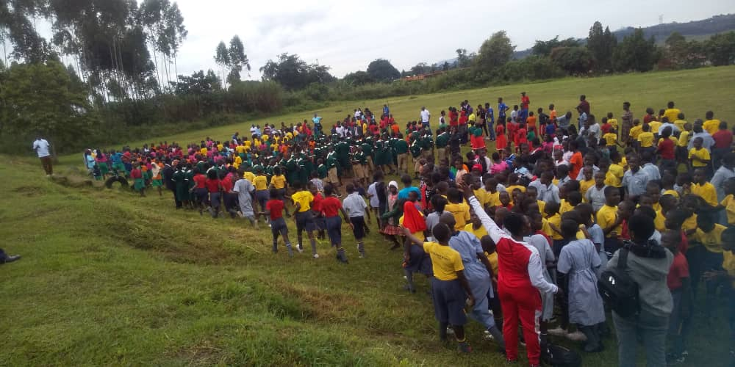
School visits

Slide 18
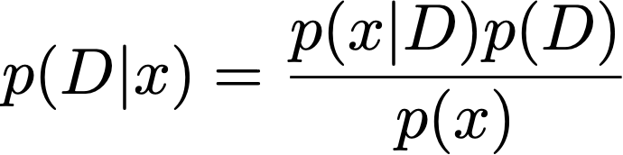
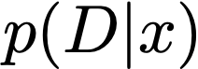
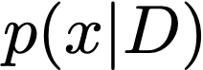
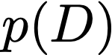
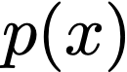
Bayes theorem
Belief/Reality | True | False
True |  | False positive
False | False negative
False positives/False negatives
Sannsynligheten for D gitt x, posterior.
Sannsynligheten for x gitt D
Prior, sannsynligheten for D før vi måler x.
Sannsynligheten for å måle x

Slide 19


Bayes theorem, eksempel
Belief/Reality | True | False
True |  | False positive
False | False negative
False positives/False negatives
=0.01
Prior, sannsynligheten for D før vi måler x.
=0.99
Sannsynligheten for positive test, x, gitt D
=0.95
Sannsynligheten for negativ test, x, gitt ikke D
=0.1667
Sannsynligheten for D gitt positiv test, x, posterior.
=0.99
Sannsynligheten for ikke D gitt negativ test.
risk=sannsynlighet x konsekvens

Slide 20


